Slide 1

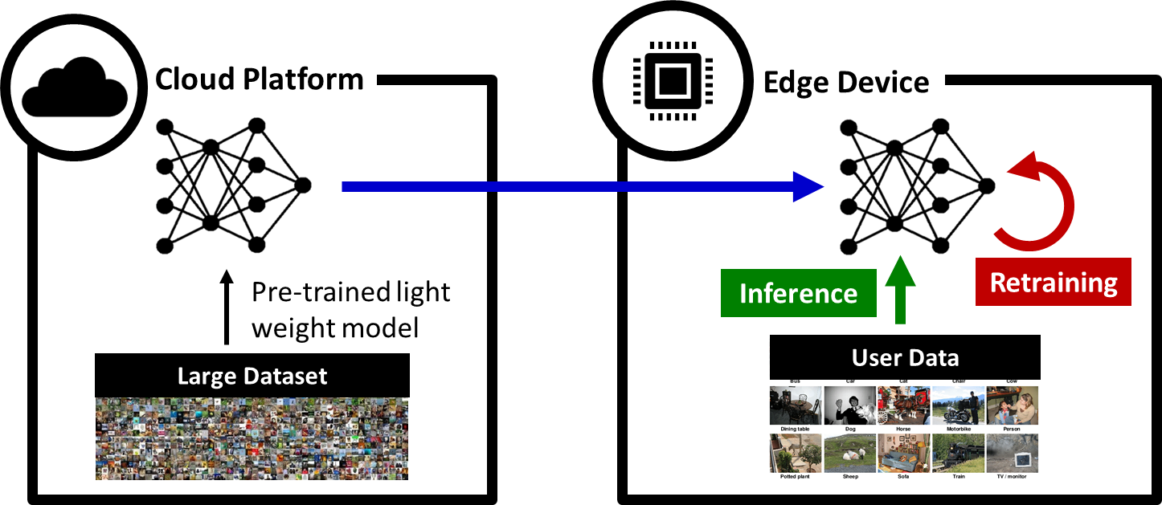
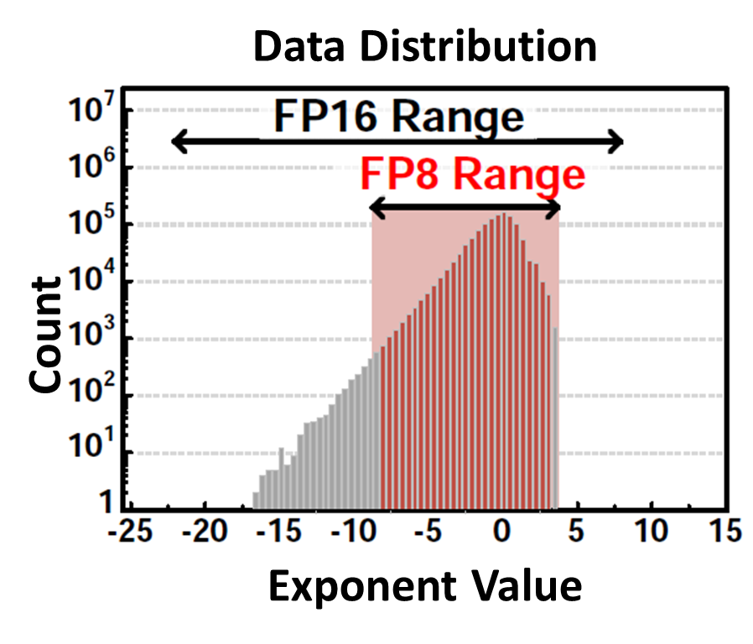
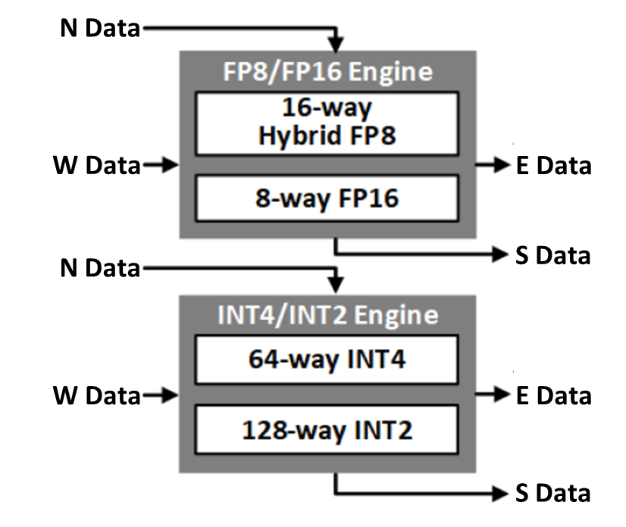
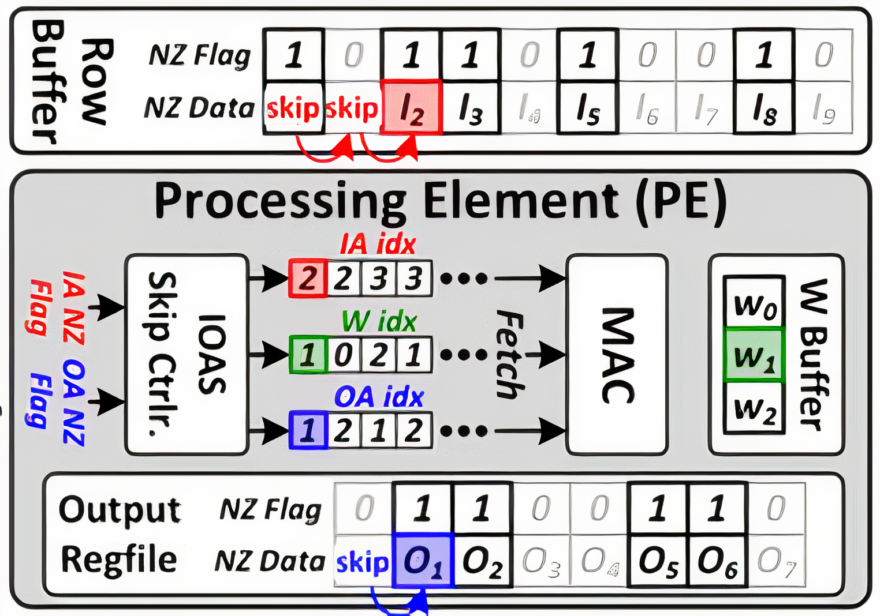
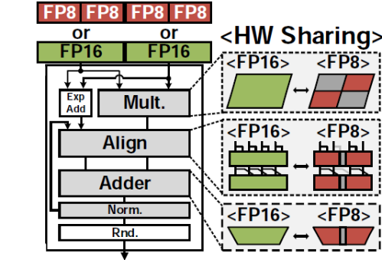
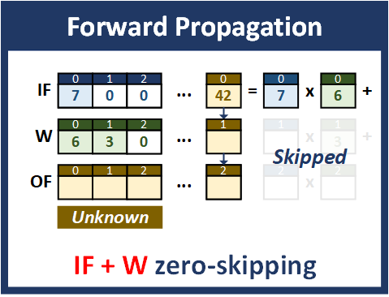
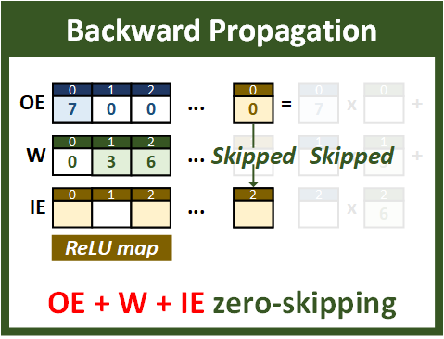
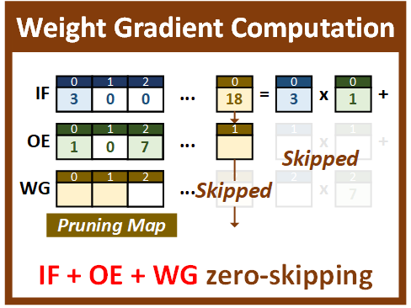
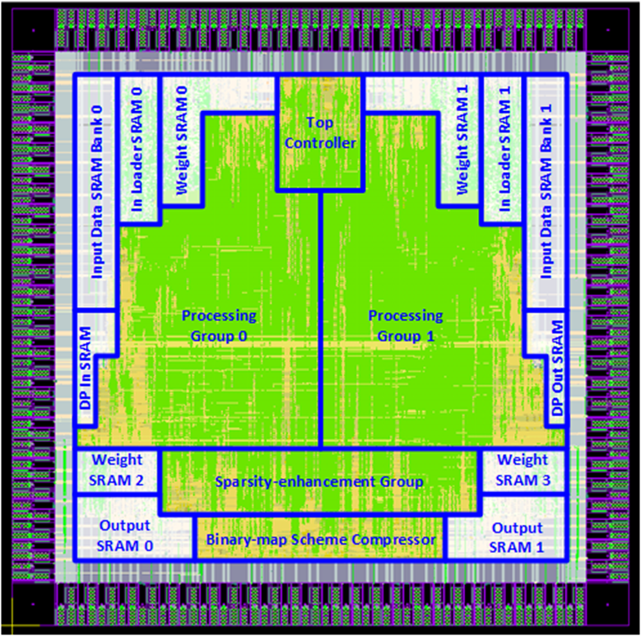
Energy-Efficient AI Accelerator for On-Device Training
Zih-Sing Fu and Chia-Hsiang Yang
National Taiwan University
Research Overview
Design Goal: Neural network training for edge device
Motivation Energy-efficient AI accelerator for on-device training
Challenges & Analyzed Techniques
Training requires large computation
→ Exploiting sparsity in data to skip zero MAC
Training requires large data dynamic range
→ Selecting appropriate data type for training
Training requires large external memory access (EMA) [1]
→ Reducing EMA with compression
Sparsity Exploitation
Data Type for Training
Training complexity >> inference complexity
Utilize sparsity-aware architecture to reduce computation
[2,3] exploits sparsity of activations and errors
[4] exploits sparsity of activations and weights
Sparsity appears in all stages in neural network training
Activations and errors: ReLU
Weights and gradients: Pruning
Mixed-precision MAC [2]
Data → FP8/FP16 tensors
x2 throughput for PF8
Low precision at inference [5]
Inference: INT4 / INT2
Training: FP16 / Hybrid-FP8
Data Compression
Run-length encoding
CR related to distribution
Skip-idx width hard to decide
Binary-mask scheme
CR indep. of distribution
65% EMA↓ at training
Sparsity-aware architecture example [3]
Skip-Index
Data
Sparsity that can be exploited in neural network training
Chip Layout & Performance
System Architecture
Technology | 40nm CMOS
Chip Size | 2.78 x 2.78 mm²
Core Size | 2.20 x 2.20 mm²
Gate Count | 7113K
On-chip SRAM (KB) | 160
Max. Frequency | 200MHz
Peak Performance (TOPS) | 20.48 (8 bit)
Area Efficiency (GOPS/mm²) | 4266.7 (8 bit)
Sparse Convolution
 |  | ISSCC'19 [2] | ISSCC'20 [3] | ISSCC'21 [5] | This Work
Supported Operations | Sparsity Exploitation | Yes | Yes | No | Yes
 | Sparsity Inducing | No | No | No | Yes
 | Training Precision* | 16 bit | 16 bit | 16 bit | 8 bit
 | Compression | No | No | No | Yes
Technology |  | 65nm | 65nm | 7nm | 40nm
Supply Voltage (V) |  | 0.78 - 1.1 | 0.7 - 1.1 | 0.55 - 0.75 | 0.9
Area (mm²) |  | 16.0 | 32.4 | 19.6 | 4.8
On-chip SRAM (KB) |  | 372 | 676 | 8000 | 160
Max Frequency (MHz) |  | 200 | 200 | 1600 | 200
Peak Performance* (TOPS) |  | > 0.3 | 14.03 | 25.6 | 20.48
Area Efficiency (GOPS/mm²) |  | 24.0 | 433.0 | 1306.1 | 4266.7
Memory Banks
Post processing
* Max precision required for training
[1] T.-J. Yang et al., "Designing energy-efficient convolutional neural networks using energy-aware pruning," CVPR, June 2017.
[2] J. Lee et al., "LNPU: A 25.3 TFLOPS/W sparse deep-neural-network learning processor with fine-grained mixed precision of FP8-FP16," ISSCC, Feb. 2019.
[3] S. Kang et al., "7.4 GANPU: A 135TFLOPS/W multi-DNN training processor for GANs with speculative dual-sparsity exploitation," ISSCC, Feb. 2020.
[4] Y. Yu et al., "SPRING: A Sparsity-Aware Reduced-Precision Monolithic 3D CNN Accelerator Architecture for Training and Inference," IEEE Transactions on Emerging Topics in Computing, 2020.
[5] A. Agrawal et al., "A 7nm 4-Core AI Chip with 25.6TFLOPS Hybrid FP8 Training, 102.4TOPS INT4 Inference and Workload-Aware Throttling," ISSCC, Feb. 2021.

